Slide 1
Diabetes Prediction
Souvik Chakraborty

Slide 2
Points to Explore
Problem Statement & Task
Approach to Address
Selected Parameters
Dataset
Used Software, Libraries & Algorithms
Source code
Output & Conclusion
date of delivery – within 35 days

Slide 3
Problem Statement & Task
Problem
Task
Diabetes is a type of chronic disease which is more common among the people of all age groups. Predicting this disease at an early stage can help a person to take the necessary precautions and change his/her lifestyle accordingly to either prevent the occurrence of this disease or control the disease.
Prepare the data-set using several methods to train the model.
Build a model which can give high accuracy of predicting the disease.

Slide 4
Approach to Address
Before coding
Selecting correct parameters for creating the diabetes dataset.
Evaluating the parameters and dropping the unnecessary one.
During coding
Normalizing all the input parameters at a standard level.
Creating the train and test datasets for the ML algorithms.
Predicting through various algorithm, to find the most accurate one.

Slide 5
Parameters
Gender
Age
Hypertension
It has been observed that diabetes mellitus can have some gender peculiarities and some data show that women have more years of disease on average than their male counterparts and have a higher body mass index (BMI).
Middle age is when diabetes diagnoses really start to spike. An estimated 14% of Americans ages 45 to 64, or 11 million people, are diagnosed with type 2. That is almost five times the rate for those 18 to 44.
Hypertension and diabetes share a number of common causes and risk factors. A person who has one condition is at an increased risk for developing the other.

Slide 6
Parameters
Heart Disease
BMI
HbA1c
Diabetes and heart disease often go hand in hand. Learn how to protect your heart with simple lifestyle changes that can also help you manage diabetes.
The risk of developing DM at 30 ≤ BMI ≤ 39.99 relative to persons with normal BMI was nearly the same for both men and women (HR=1.98 for men vs. HR=1.96 for women).
A high HbA1c means you have too much sugar in your blood. This means you are more likely to develop diabetes complications, like serious problems with your eyes and feet.

Slide 7
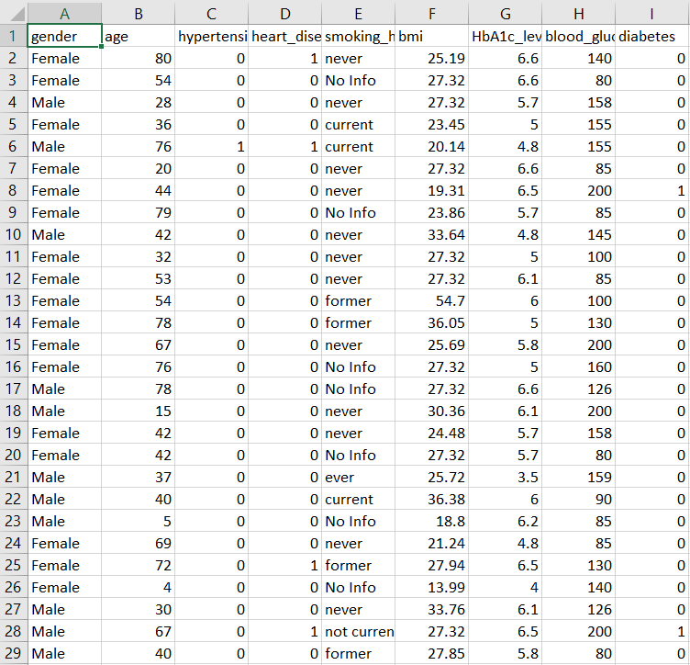
Dataset

Slide 8
Used
Software
Libraries
Algorithms
MS-Excel (to build and analyze the dataset)
VS Code (used to write the python code for predictive analysis)
1. Pandas
2. NumPy
3. Scikit-Learn
4. Matplotlib
1. Logistic Regression
2. Decision Tree
3. Linear Regression

Slide 9
code
#___Importing all the Libraries needed for the project___#
import pandas as pd
import numpy as np
import matplotlib.pyplot as plt
from sklearn import preprocessing
from sklearn.model_selection import train_test_split
from sklearn.linear_model import LogisticRegression
from sklearn.tree import DecisionTreeClassifier
from sklearn.linear_model import LinearRegression
from sklearn.model_selection import cross_val_score
import sklearn.metrics as metrics
#___Importing the Raw data___#
data = pd.read_csv("F:\My_python_programs\Diabetes Dataset\diabetes_prediction_dataset.csv")
#print(data)
#___Preprocessing of the inserted raw data___#
Parameter = data.iloc[:,2:7]
resultant = data.iloc[:,data.columns == 'diabetes']
initial_dataset = pd.concat([Parameter,resultant],axis=1)
str2int = preprocessing.LabelEncoder()
initial_dataset['smoking_history'] = str2int.fit_transform(initial_dataset['smoking_history'])
#print(initial_dataset)

Slide 10
code
#___visualising the data using matplotlib library___#
outcome_count = pd.value_counts(initial_dataset['diabetes'], sort = True).sort_index()
outcome_count.plot(kind = 'bar', color='yellow')
plt.title('diabetes histogram', fontweight='bold', fontsize='15', color='red')
plt.xlabel('diabetes', fontweight='bold', fontsize='15', color='gray')
plt.ylabel('Frequency', fontweight='bold', fontsize='15', color='gray')
#print(plt.show())
#___all columns have to standard with respect to other___#
stan = preprocessing.StandardScaler()
initial_dataset['new_bmi'] = stan.fit_transform(initial_dataset['bmi']. values.reshape(-1,1))
final_dataset = initial_dataset.drop(['bmi'], axis = 1)
#print(final_dataset)
#___Split data for training and testing___#
final_parameter = final_dataset.iloc[:,final_dataset.columns != 'diabetes']
final_resultant = final_dataset.iloc[:,final_dataset.columns == 'diabetes']
x_train, x_test, y_train, y_test = train_test_split(final_parameter, final_resultant, test_size = 0.2)

Slide 11
code
#___Applying Logistic Regression___#
model = LogisticRegression()
model.fit(x_train, y_train.values.ravel())
result = model.predict(x_test)
accuracy = model.score(x_test,y_test)
print("Accuracy using Logistic regression:", accuracy)
#___Applying Decission Tree Classifier___#
clf = DecisionTreeClassifier(criterion="entropy", max_depth=4)
clf = clf.fit(x_train,y_train)
yPred = clf.predict(x_test)
scores = cross_val_score(clf, y_test, yPred, cv=10)
print("Accuracy using Decision tree:",metrics.accuracy_score(y_test, yPred))
#print(scores)
#__Applying Linear Regression__#
reg = LinearRegression()
reg.fit(x_train,y_train)
y_pred = reg.predict(x_test)
print("Root mean squared error: ", np.sqrt(metrics.mean_squared_error(y_test, y_pred)))

Slide 12
Output
Code result
Observation
Accuracy using Logistic regression: 0.94425
Accuracy using Decision tree: 0.95485
Root mean squared error: 0.2424602229405095
After observing the program outcome, we can say that Linear regression is the perfect algorithm to be used in order to get maximum accuracy for the diabetes predicting task.

Slide 13
Conclusion
It was a good opportunity with an exciting project to step into the field of Data Science. There are countless number of application of Data Science. In this project we are creating a diabetes dataset and with the help of libraries, we are performing predictive analysis. It is done to catch an early onset of diabetes in a healthy person, so that we can treat the disease in an early stage. By completing the whole project, I have gathered knowledge on various ML algorithms, Data pre-processing and creating a perfect dataset.

Slide 14
Thank You
Souvik Chakraborty
https://www.linkedin.com/in/souvik-chakraborty-a14a86204/

